Slide 1


Prompt
Engineering
by RocketMind academy

Slide 2










RocketMinders
www.linkedin.com/in/luismanez
www.linkedin.com/in/rubentg
luis.manez@outlook.com
rtoribiogallardo@gmail.com
github.com/luismanez
github.com/Rtoribiog
twitter.com/luismanez
twitter.com/Rtoribiog
Luis Mañez
Ruben Toribio
RocketMind Academy CTO
RocketMind Academy CEO
Azure AI + M365 Development MVP
AI Expert / Full stack developer

Slide 3
01
Introduction

Slide 4

What is a
Prompt
Engineering
?

Slide 5
A prompt is an input given to an AI model, designed to initiate a specific response or action

Slide 6
Prompt Engineering
A set of techniques, good practices, and patterns to improve the quality of your prompt

Slide 7
Simple Prompt
"Tell me about machine learning.”
Better Prompt
"Explain the concept of machine learning in simple terms for a high school student and give me 3 samples of real-world use cases”

Slide 8



Enhanced Accuracy and Relevance
Efficiency in task execution
Save tokens / money

Slide 9
02
Techniques

Slide 10
LLM API Settings
Add clear syntax
System Message
Break the task down
Few-Shot prompting
Use of affordances
Start with clear instructions
Chain of thought prompting
Repeat Instructions at the end
Specifying the output structure
Prime the output
Provide grounding context

Slide 11

System Message
Primes the model with relevant context, instructions, or information.
This assistant is specialized in providing support for Microsoft Azure AI technologies. It is designed to clarify concepts, offer real-world examples, and assist in content creation. When responding, prioritize information related to Azure AI services, ensuring responses are detailed, accurate, and tailored to developers' needs.
Defines the assistant's personality and response format.
You are an educational assistant designed to provide clear, concise, and informative responses. Please use simple language suitable for learners of all levels. Responses should be structured with bullet points for easy reading, and important terms should be highlighted in bold.
Outlines what the model should and shouldn't answer.
You must not provide medical or legal advice under any circumstances. Focus on topics related to general knowledge, educational content, and non-sensitive guidance. Avoid topics that could lead to ethical, privacy, or safety concerns

Slide 12
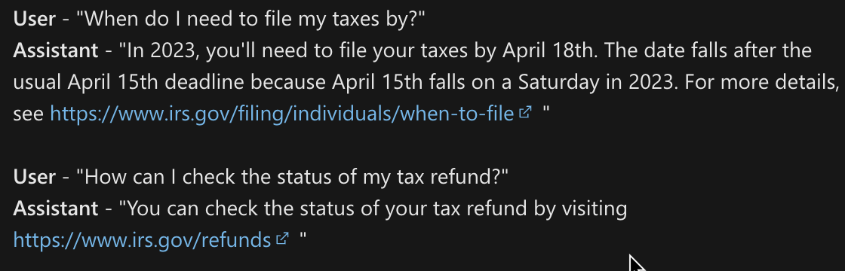
Few-Shot Prompting
Adapt language models to new tasks by using a small set of training examples
Set of examples directly into the prompt to give the model additional context.
When using the API, a series of messages between the user and assistant as examples for few-shot prompting, effectively creating a fictional chat history to serve as training examples.

Slide 13
Start with clear instructions
Give as much clear instructions as you can. The less the model must guess at what you want, the more likely you’ll get it.
Provide any important details or context
Delimiters like, XML tags, section titles, etc. can help demarcate sections of text to be treated differently
Some tasks are best specified as a sequence of steps.

Slide 14
Repeat instructions at the end
Recency Bias in Models
Information at the end of the prompt can be more significant and be more influence on the output
Repeating instructions at the end of the prompt could be beneficial

Slide 15
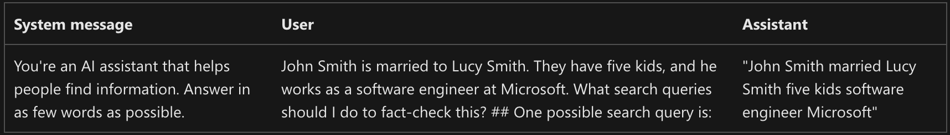
Prime the output
Also known as Cues
Provides a starting point for the model’s output
Direct the model towards the desired response

Slide 16
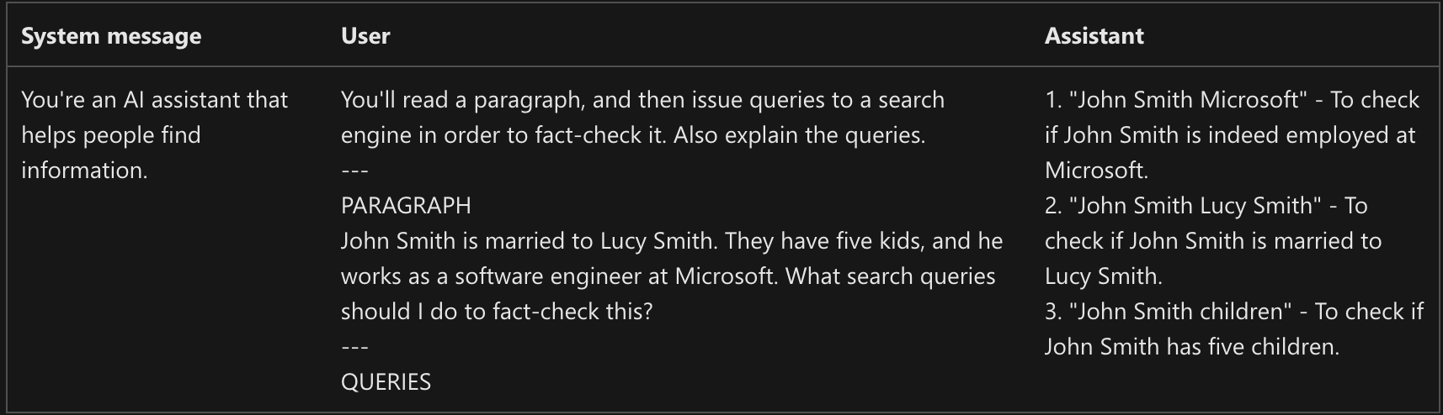
Add clear syntax
Include punctuation, headings and section markers to your prompt.
Express intent
Markdown or XML syntax

Slide 17
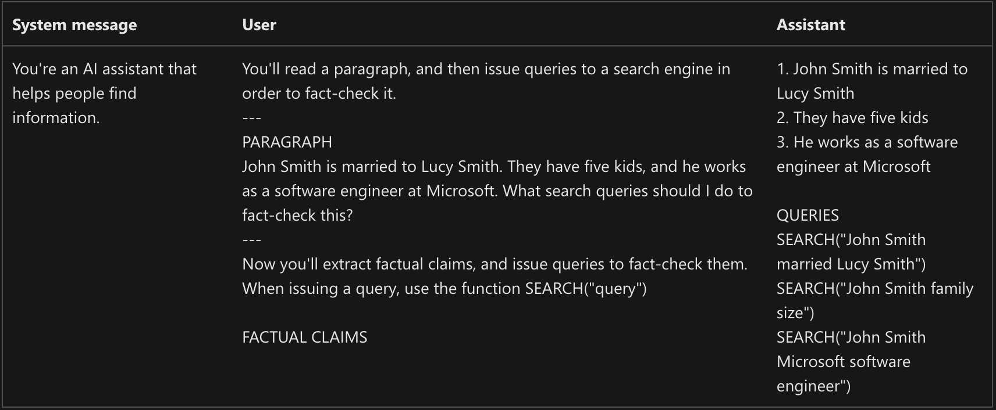
Break the task down
“Divide and conquer”
Works better when need complex reasoning

Slide 18
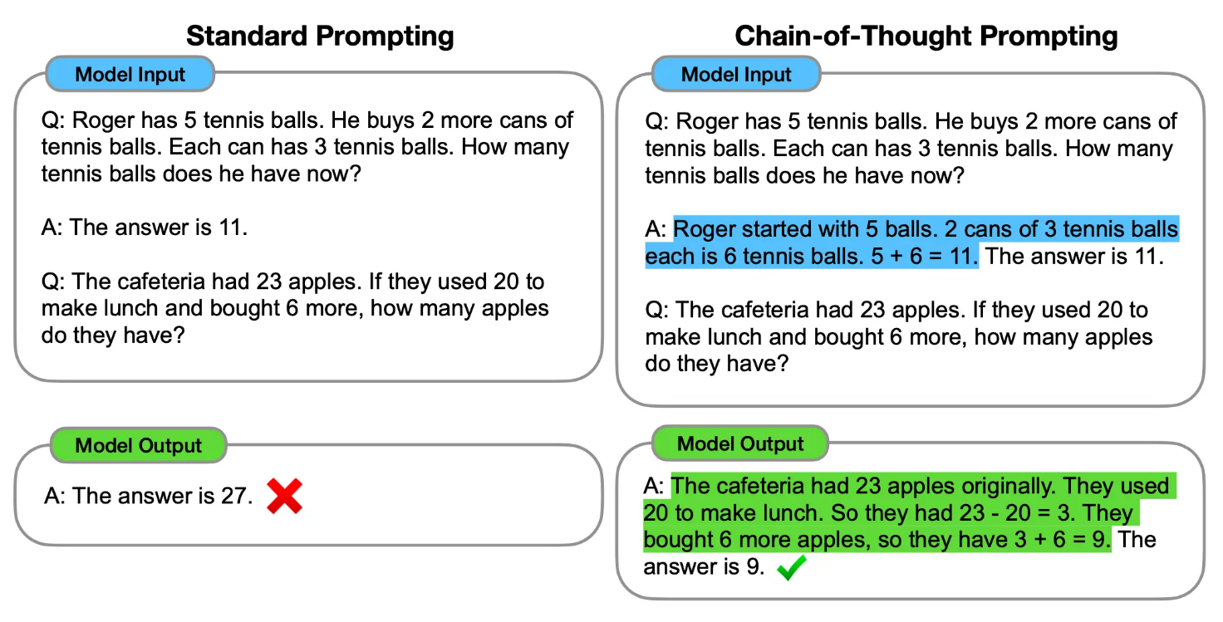
Chain of thought prompting
Variation on the break the task down
Enables complex reasoning capabilities
Model response is instructed to proceed step-by-step and present all the steps involved
Reduces the possibility of inaccuracy

Slide 19
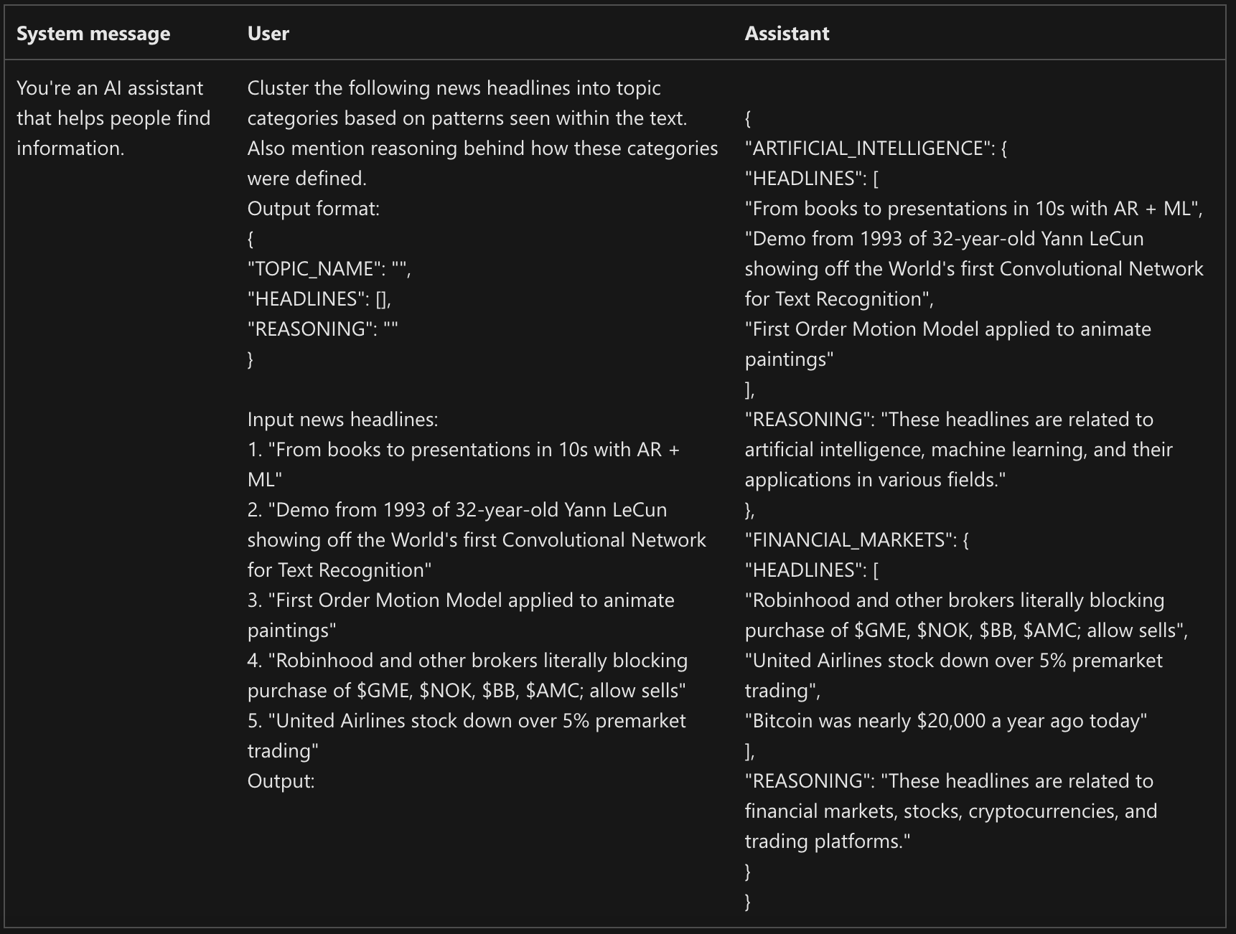
Specifying the output structure
Sometimes, just telling the Prompt to do not made-up information might not be sufficient
Ask the model to include citations
Make 2 errors is harder than make 1

Slide 20
Provide grounding context
Provide the model with specific data
Helps with up to date or domain-specific questions
Basis for the RAG pattern

Slide 21
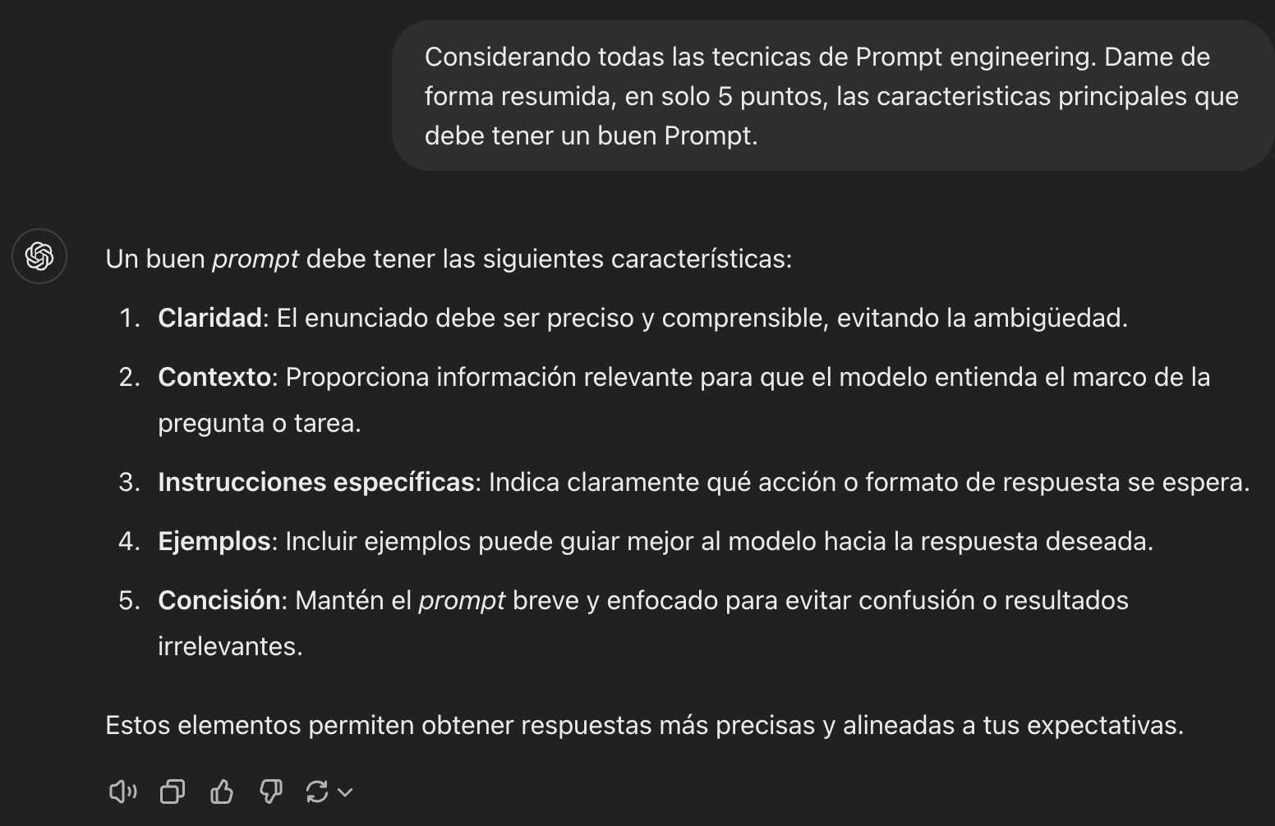
Summary (courtesy of ChatGPT)

Slide 22
Prompt Tips in GitHub Copilot
1. Set the Stage with a High-Level Goal
Provide a broad description of your objective early (e.g., “Create a markdown editor in Next.js with live preview” ).
Example: A comment listing features like React hooks, state management, and markdown rendering helped Copilot generate a functional editor in seconds.
2. Make Your Ask Simple and Specific
Break tasks into discrete steps (e.g., “Split a sentence into words,” “Remove punctuation,” “Reverse order” ).
Avoid vague requests (“Write code for grades.py” ) → Specify inputs/outputs: “Implement calculate_average_grade that takes a list of grades and returns a float.”
3. Give Examples
Share input/output pairs or desired outcomes.
Example: Extracting names from nested arrays:
findDates("I have a dentist appointment on 11/14/2023 and book club on 12-1-23")
Returns: ["11/14/2023", "12-1-23"]
// Desired output: ["John", "Jane", "Bob"]
const data = [[{name: "John"}, {name: "Jane"}], [{name: "Bob"}]];

Slide 23
Prompt Tips in GitHub Copilot
1. Experiment and Iterate
Refine prompts until you get desired results. Start vague, add constraints gradually.
Example: Iterating from “Write code for grades.py” to specifying input types and expected outputs improved accuracy.
2. Manage Contextual Files
Keep 1–2 relevant files open for context (e.g., manifest.json while building a Chrome extension).
Highlight code blocks for Copilot Chat to reference.
3. Follow Good Coding Practices
Use descriptive names (authenticate_user vs. rndpwd ) and consistent styles.
Well-structured code improves Copilot’s suggestions. Example:
def authenticate_user(username, password):
if is_valid_user(username, password):
generate_session_token(username)
return True

Slide 24
Example Prompt
Goal : Build a Chrome extension that changes background color based on time of day.
Steps:
Define the Goal : “Create a browser extension that dynamically updates background color based on current hour.”
Break It Down :
Generate manifest.json.
Build popup.html UI.
Write JavaScript to detect time and set colors.
Add event listeners for theme toggling.
Example Prompt :
// Function to determine background color by time
// Morning (6AM–12PM): Light yellow
// Afternoon (12PM–6PM): Light blue
// Night (6PM–6AM): Dark gray
Result : Copilot generates conditional logic for dynamic theming.

Slide 25
Summary
Start general, then get specific: Begin with a broad description, then add specific requirements.
Give examples: Provide example inputs, outputs, or test cases to clarify your intent.
Break complex tasks into simpler tasks: Divide large problems into smaller, manageable steps.
Avoid ambiguity: Be explicit about what you want and reference specific code, functions, or libraries.
Indicate relevant code: Open or highlight the code you want Copilot to use as context.
Experiment and iterate: Refine your prompts if you don’t get the desired result.
Keep history relevant: Use threads for new tasks and remove irrelevant chat history.
Follow good coding practices: Use clear naming, consistent style, comments, and modular code to help Copilot understand your codebase.

